Slide 1
Statistical Methods in Geography
Sem-3

Slide 2
Frequency curve
A Frequency Curve is a smooth curve which corresponds to the limiting case of a histogram computed for a frequency distribution of a continuous distribution as the number of data points becomes very large.

Slide 3
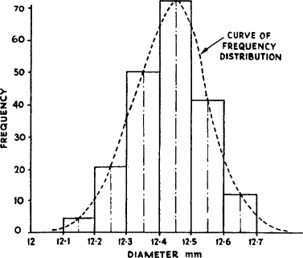
Frequency Curve

Slide 4
Frequency Polygon
A frequency polygon is a line graph of class frequency plotted against class midpoint. It can be obtained by joining the midpoints of the tops of the rectangles in the histogram

Slide 5
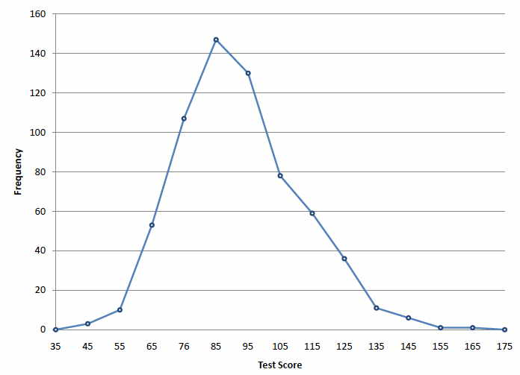
Frequency Polygon

Slide 6
Histogram
In statistics, a histogram is a graphical representation of the distribution of data. The histogram is represented by a set of rectangles, adjacent to each other, where each bar represent a kind of data.

Slide 7
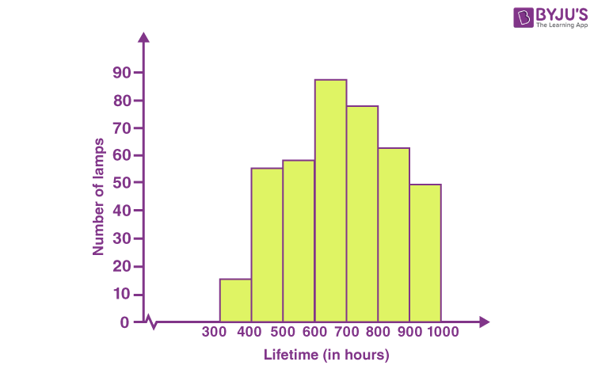
Histogram

Slide 8
THANK YOU

